Slide 1

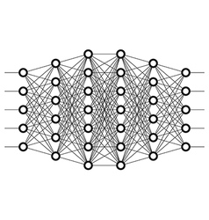
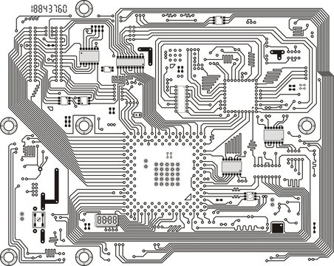
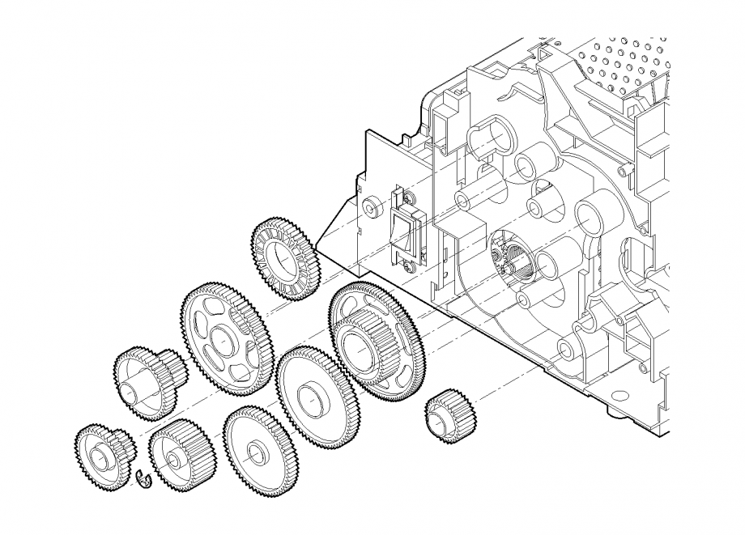

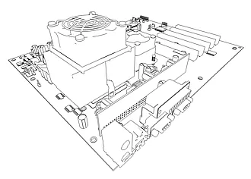




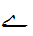

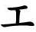


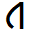

Pattern Recognition
From Curve Fitting to Generalization
This Photo by Unknown Author is licensed under CC BY-SA

Slide 2
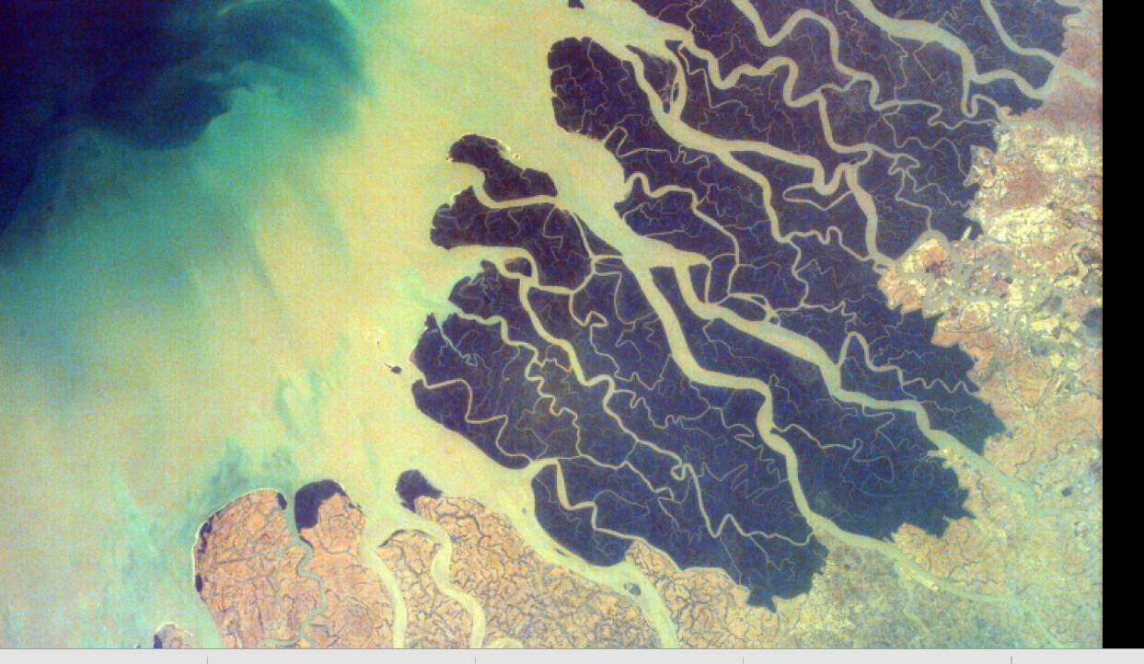
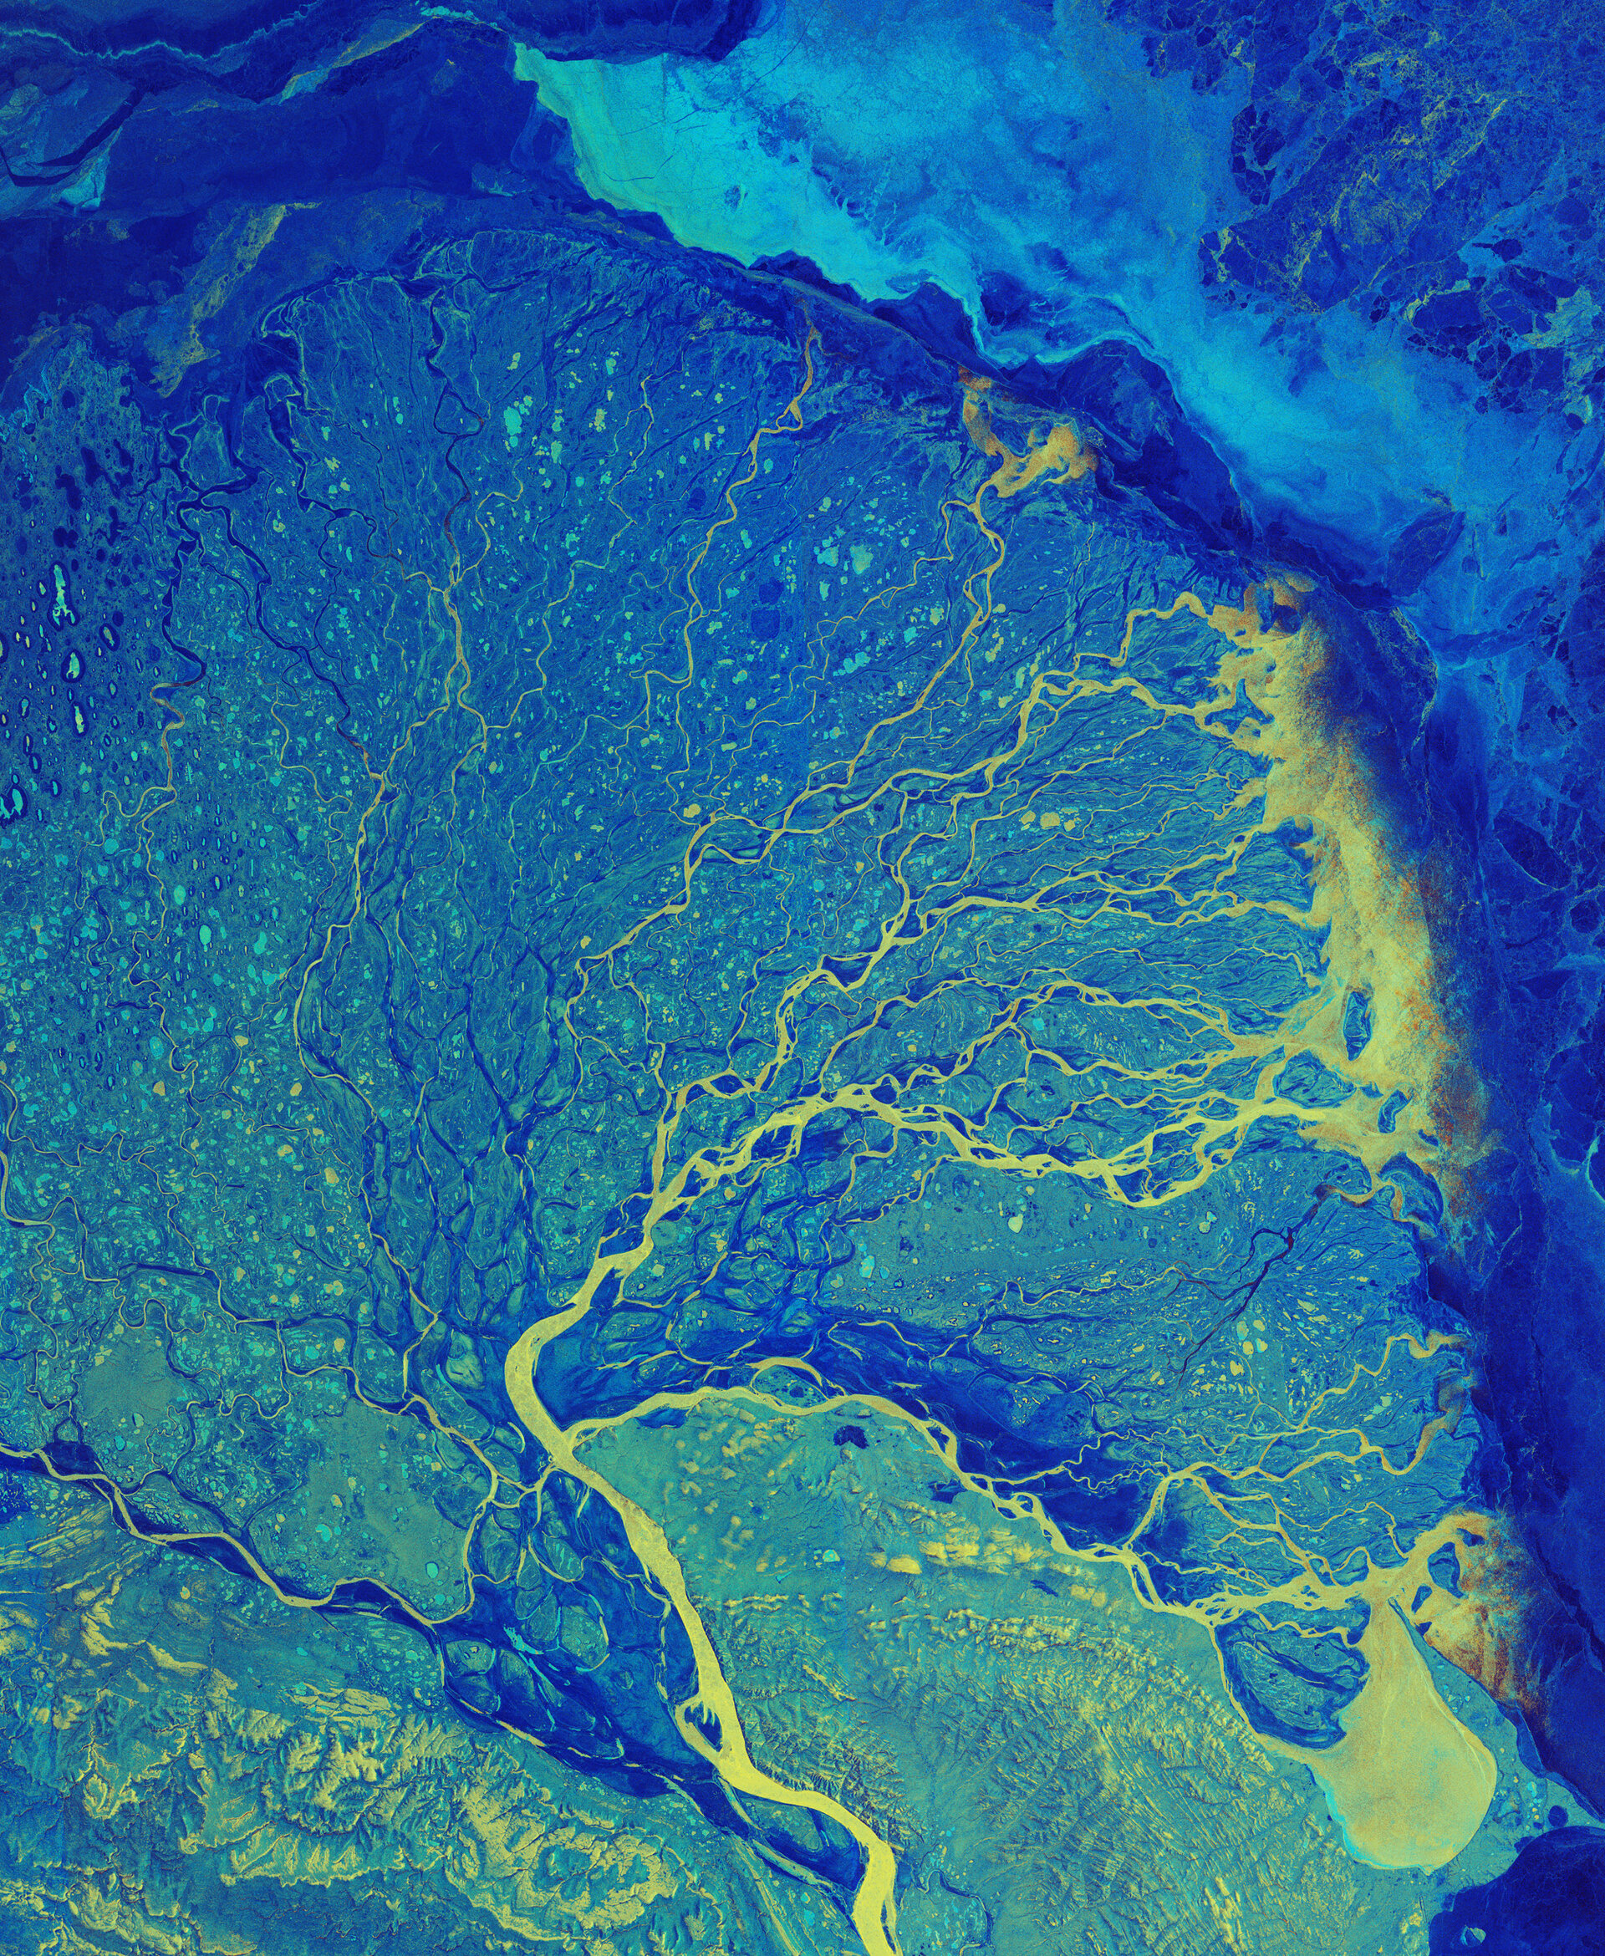
Case Study
Ganges Delta in India & Bangladesh
Pic Credit: NASA
Rhine Delta
Pic Credit: European Space Agency
River System / Fluvial Networks – Can you predict this pattern

Slide 3
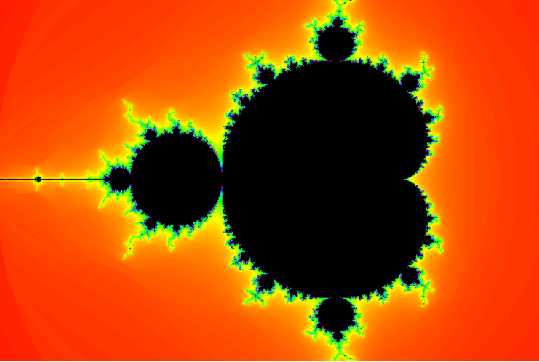

Mandelbrot Set – Demo
Pic Credit:
1: https://www.codingame.com/playgrounds/2358/how-to-plot-the-mandelbrot-set
2 : https://en.wikipedia.org/wiki/Mandelbrot_set

Slide 4
Mandelbrot Set
Simple equation can create complex system where exact pattern can’t be predicted easily ( or may be can’t be predicted at all)
Chaos: Small Changes can have large impact on system
Causality: Which factor influences outcome may not be clear

Slide 5
Pattern Recognition : Trying to sub divide the field
Traditional
Feature Engineering
Curve Fitting
Optimization
Optimization
Modern
Generalization
Self Organization

